Slide 1
S3-As-A-Service

Slide 2
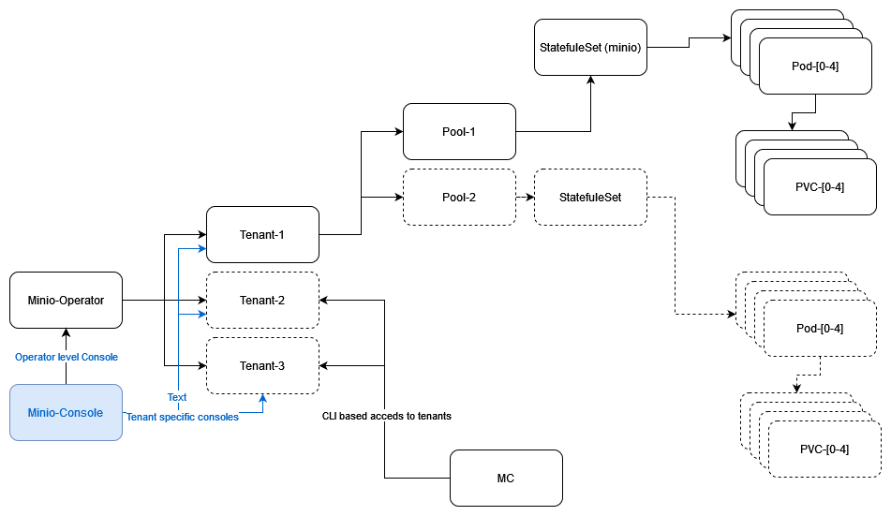
Architecture
Editable diagram
Installed in svc-mgmt-cluster in each seed using ArgoCD
Storage space calculation
User req = 50Gb
Actual storage (PVC) = User Req x 2 = 100Gb
vSphere vSAN physical storage = User Req x 2 x 4 = 400Gb
Offsite Backups on Netapp

Slide 3
Details of URLs
Sinapse Tenant Console
Sandbox - CLD BGH - currently using LDAP authentication (& Authorization)
DEV - CLD BGH - currently using LDAP authentication (& Authorization)
Prod - CLD BGH NUN - Currently access using root user provided in values.yaml
Operator consoles - access using jwt token - present in secret console-sa-token
Sandbox - CLD BGH
DEV - CLD BGH
Prod - CLD BGH NUN
ArgoCD Console URLs
Sandbox - CLD BGH
DEV - CLD BGH
Prod - CLD BGH NUN

Slide 4
Runbooks for "s3 as a service"
tenant pool expansion
pool decommissioning
argocd rollout - tag change
For s3-as-a-service - we use minio-operator and minio-operator-custom applications. ArgoCD apps are defined in <ENV>-setup/svc-cluster/svc-mgmt-<SEED>-<ENV>/argocd-apps.yaml

Slide 5
Maintenance
Alerts in Alerta
Delete Statefulset for the given tenant. (It will NOT delete the PVCs) Operator will re-create the STS.
Delete the Tenant. (It will NOT delete the PVCs). ArgoCD will recreate the Tenant. Tenant will recreate the STS.
Pool Expansion
Pool Contraction (Decommissioning)

Slide 6
Offsite Backup
We run s3-syncer job all vsphere seeds to do offsite backup of buckets which are marked with tags backup=yes
S3-syncer job is deployed using ArgoCD in svc-mgmt-clusters.
Target for the buckets is netapp
Job runs every 30 minutes
Source code: /common/components/svc-mgmt-s3-syncer
Values: (for dev-bgh): /secrets/dev-setup/svc-mgmt-bgh-dev/values.yaml

